Slide 1
EXOTIC OPTIONS
By-
Krati Saxena
Akhil Arora
Ankit Singh
Tavish Garg

Slide 2
INTRODUCTION
An Exotic Option is a more complex contract than simple European or American call or put option on stock, index, foreign currency, commodity or interest rate. Exotic options are the second generation of options
Instead of combining plain vanilla options to create desired payoff diagrams, lower costs, and reach other objectives, a trader would directly design new option contracts that can do similar things in a “better” fashion.
Of course, these new contracts imply a hedge that is, in general, made of the underlying plain vanilla options, but the new instruments themselves would sell as exotic options

Slide 3
WHY EXOTIC OPTIONS?
Opportunity to explore wider bid-offer spread
Competition on the market is not as strong as on vanilla option market, since not many financial institutions trade exotics
Can maintain higher profit margins
Sophisticated extensions to vanilla options

Slide 4
TYPES OF EXOTIC OPTIONS
There are numerous types of exotic options, but our main focus is on following options:
Double Barrier option
Binary option
Asian option

Slide 5
BINARY OPTIONS
Also known as Digital options, its Payoff is structured to be either a fixed amount of compensation if the option expires in the money, or nothing at all if the option expires out of the money.
Binary options are generally European style options.
Binary options are offered against a fixed expiry time.

Slide 6
BINARY OPTION (CONT…)
The payoff can be written as
C^{bin}(S)= R, if stock is trading at or up the
strike price
= 0, otherwise
Taking price dynamics as a separate subject, the only difference between a binary and standard option is its payout profile. A binary option pays out a fixed amount, while a standard vanilla option pays out a potentially unlimited variable amount. Both options can expire worthless "out of the money." If the underlying instrument moves "in the money", a binary will pay a fixed amount, say $10, while a vanilla option will pay anywhere from $0 to infinity depending on how much the underlying instrument clears the strike price

Slide 7
BARRIER OPTIONS
Compared to vanilla options, they have one additional key term: BARRIER imposed on price of underlying.
The barrier might be below or above the strike price
When barrier is hit during the life of option, the contract might be cancelled or it may become effective

Slide 8
BARRIER OPTION (CONT…)
Based on this, we have four basic types of barrier options:
down-and-out – the barrier is below the strike price; once it is hit, the option “dies” and at maturity there is no payout for option holder, although the option might be in-the-money at maturity;
down-and-in – the barrier is also below the strike price, but this time the contract becomes alive when the barrier is hit – at maturity option holder gets usual payout if and only if the barrier is hit during the life of the option; if the barrier is not hit, the option expires worthless, although it might be in-the-money at maturity;
up-and-out – this time the barrier is above the strike price; once it is hit, the contract becomes “nulled” – there is no payout for option holder at maturity, no matter if the option is in-the-money or out-of-the-money;
up-and-in – the barrier is also above the strike price; option holder gets usual payout if and only if the stock price hits the barrier during the life of the option.

Slide 9
BARRIER OPTION (CONT…)
There are other possible features that can be applied to four basic types of barrier options. The option might be said to have two barriers instead of one. There are two basic types of double barrier options:
up-and-out-down-and-out
up-and-in-down-and-in
For the former type the contract “dies” if either lower or upper barrier is hit during the life of the option. For the latter type the option becomes effective if and only if either lower or upper barrier is hit.

Slide 10
BARRIER OPTION (CONT…)
Another feature that occurs with barrier options is a rebate. Barrier option with a rebate pays certain amount of money to option holder once the barrier is reached. This is often the case for “out” options – although the contract “dies”, the option holder receives rebate to reduce his loss on losing the payout. The rebate might be paid as soon as the barrier is reached or later, even at maturity.

Slide 11
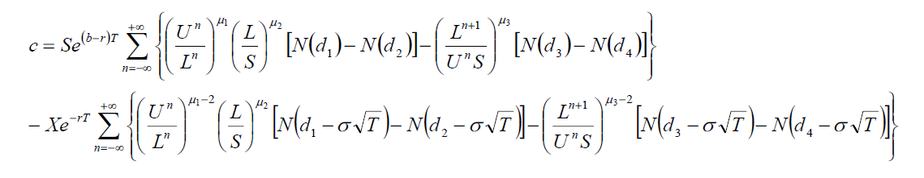
PRICING OF BARRIER OPTION
The value of the option is determined by

Slide 12
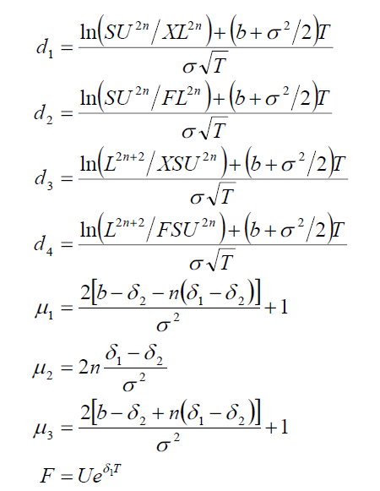
PRICING (CONT…)
Where

Slide 13
PRICING (CONT...)
S is current underlying price, X is a strike price, U is upper barrier, L is lower barrier, r is risk-free interest rate, b is cost of carry, T is time to maturity (in years), σ is annualized volatility, N(.) denotes cumulative distribution function of standardized Normal distribution and δ₁, δ₂ determine the curvature of the lower barrier L and the upper barrier U.

Slide 14
ADVANTAGES AND DISADVANTAGES OF BARRIER OPTIONS
Advantages of Barrier Options
Cheaper than conventional options
Higher resulting profit than conventional options should barrier criterias are satisfied.
Disadvantages of Barrier Options
Higher risk of loss due to barrier features.
Not publicly traded.

Slide 15
ASIAN OPTION
Asian options are options in which the underlying variable is the average price over a period of time. Because of this fact, Asian options have a lower volatility and hence rendering them cheaper relative to their European counterparts
They are broadly segregated into- arithmetic average Asians, geometric average Asians and both these forms can be averaged on a weighted average basis, whereby a given weight is applied to each stock being averaged

Slide 16
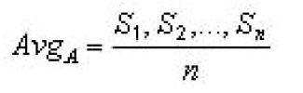
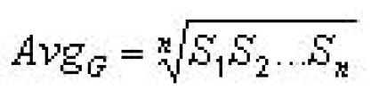
PRICING OF ASIAN OPTION
To elaborate on arithmetic averaging, this is seen as being the sum of the sampled asset prices divided by the number of samples:
and for geometric averaging, the average value is taken as:

Slide 17
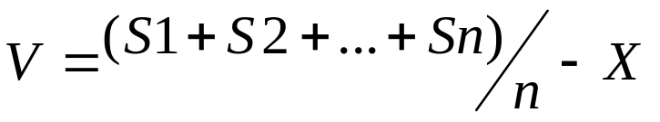
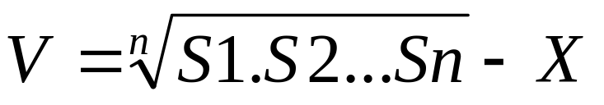
PRICING (CONT…)
The payoff functions for Asian options are given as (where X is the strike price):
for arithmetic averaging
for geometric averaging

Slide 18
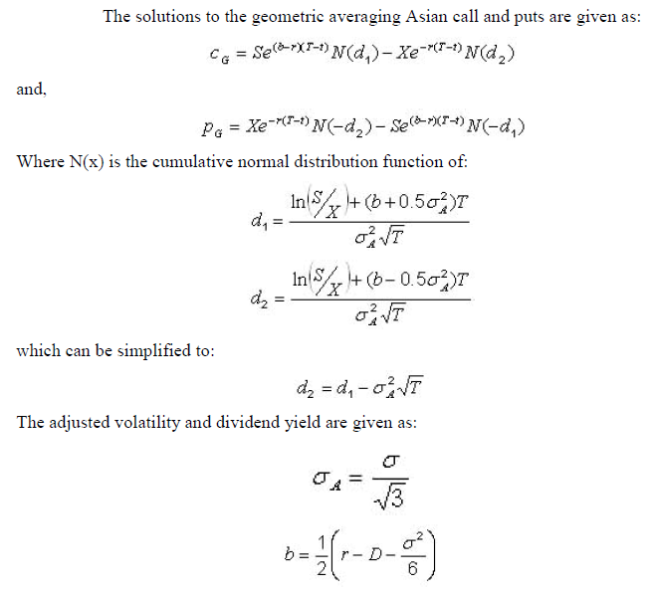

Slide 19
LOOKBACK OPTION
An exotic option that allows investors to "look back" at the underlying prices occurring over the life of the option and then exercise based on the underlying asset's optimal value. This type of option reduces uncertainties associated with the timing of market entry.
There are two types of lookback options-

Slide 20
LOOKBACK OPTION(Cont)
1- Floating - The option's strike price is fixed at maturity. For a call, the strike price is fixed at the lowest price reached during the life of the option. For a put, it is fixed at the highest price. The option settles at market and against the floating strike.

Slide 21
LOOKBACK OPTION(Cont)
2- Fixed - The option's strike price is fixed at purchase. However, the option is not exercised at the market price: in the case of a call, the option holder can look back over the life of the option and choose to exercise at the point when the underlying asset was priced at its highest over the life of the option. In the case of a put, the option can be exercised at the asset's lowest price. The option settles at the selected past market price and against the fixed strike.

Slide 22
Advantages-
Completely eliminates market entry and exit timing problems.
Completely maximizes profit within the life of the options.
Disadvantages-
Expensive
Not publicly traded.

Slide 23
CHOOSER OPTION
An option contract that allows the holder to decide whether it is a call or put prior to the expiration date. Chooser options usually have the same exercise price and expiration date regardless of what decision the holder ultimately makes. Because they don't specify that the movement in the underlying asset be positive or negative, chooser options provide investors a great deal of flexibility when evaluating volatile issues.

Slide 24
CHOOSER OPTION(cont.)
Option starts at time 0, matures at T₂
At T₁ (0 < T₁ < T₂) buyer chooses whether it is a put or call
This is a package!
*chooser options are somewhat rare and tend to be issued on more stable items.

Slide 25
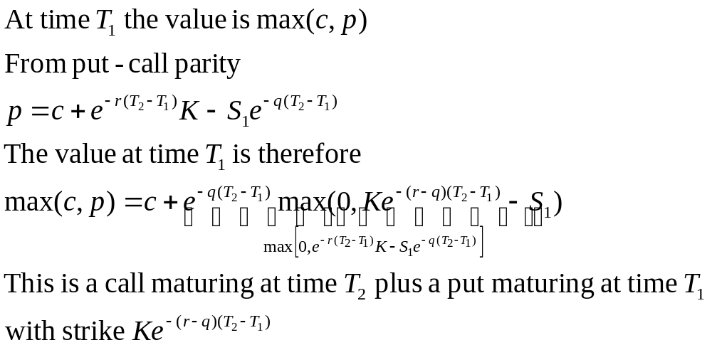
PRICING

Slide 26

Radon-Nikodym Derivative
In mathematics, the Radon–Nikodym theorem is a result in measure theory that states that, given a measurable space (X, Σ), if a σ-finite measure ν on (X, Σ) is absolutely continuous with respect to a σ-finite measure μ on (X, Σ), then there is a measurable function f : X → [0, ∞), such that for any measurable subset A ⊂ X:
The function f is called the Radon–Nikodym derivative and denoted by dν/dμ.

Slide 27
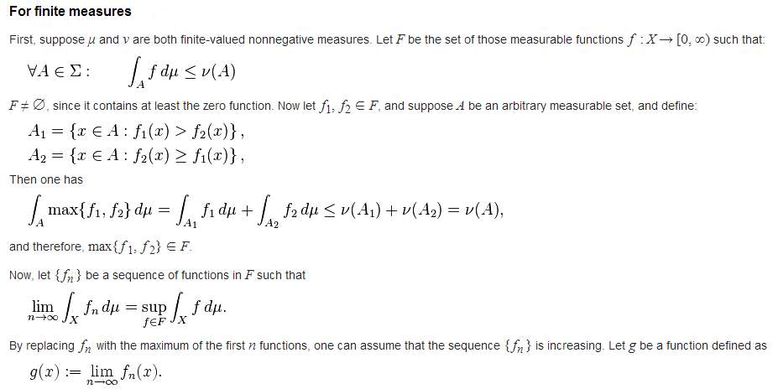
Proof-
For finite measures μ and ν, the idea is to consider functions f with f dμ ≤ dν. The supremum of all such functions, along with the monotone convergence theorem, then furnishes the Radon–Nikodym derivative.

Slide 28
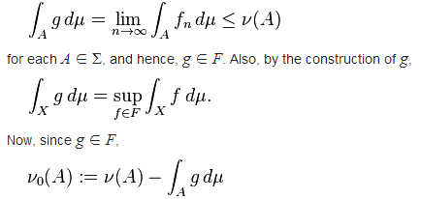
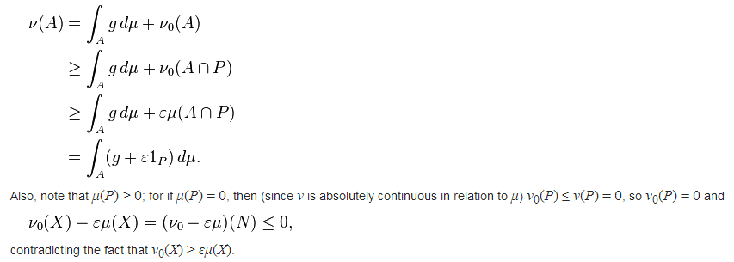
By montone convergance theorem one has-
defines a nonnegative measure on Σ. Suppose ν₀ ≠ 0; then, since μ is finite, there is an ε > 0 such that ν₀(X) > ε μ(X). Let (P, N) be a Hahn decomposition for the signed measure ν₀ − ε μ. Note that for every A ∈ Σ one has ν₀(A ∩ P) ≥ ε μ(A ∩ P), and hence

Slide 29
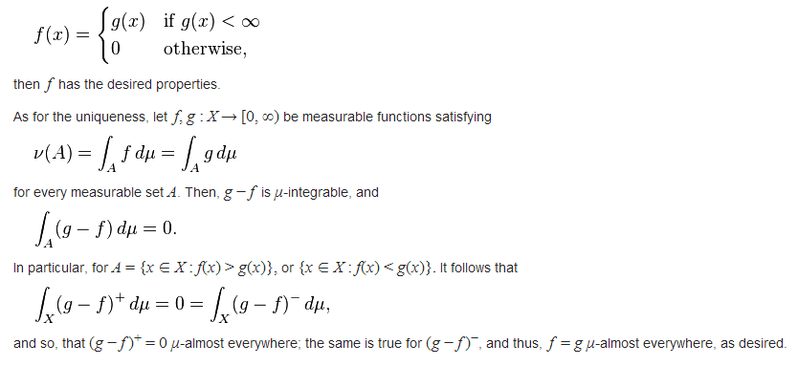
This is impossible, therefore, the initial assumption that ν₀ ≠ 0 must be false. So ν₀ = 0, as desired. Now, since g is μ-integrable, the set {x ∈ X : g(x) = ∞} is μ-null. Therefore, if a f is defined as

Slide 30

For σ-finite positive measures-
If μ and ν are σ-finite, then X can be written as the union of a sequence {B_{n}}_{n} of disjoint sets in Σ, each of which has finite measure under both μ and ν. For each n, there is a Σ-measurable function f_{n} : B_{n} → [0, ∞) such that
for each Σ-measurable subset A of B_{n}. The union f of those functions is then the required function.
As for the uniqueness, since each of the f_{n} is μ-almost everywhere unique, then so is f .

Slide 31
REAL DATA ANALYSIS
We have used BSE index data for Maruti Suzuki for 1 year.
We tried to find the call and put option prices for different strike prices.
Following data was used:
Risk-free rate of interest: 8.89%
Rate of interest: 9%
Time of expiry: 1 year from now
Stock price: Today's stock price=1935.7

Slide 32
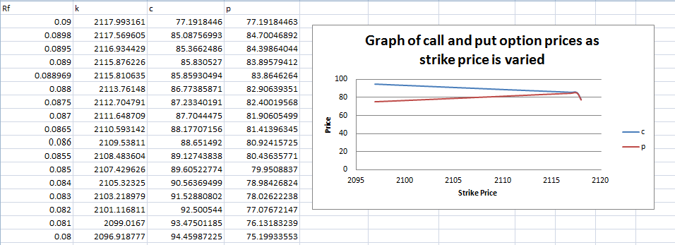
REAL DATA ANALYSIS (CONT...)
Following results were obtained:

Slide 33
REAL DATA ANALYSIS (CONT...)
We also analyzed the behavior of profit and loss for call and put options
Here, Strike price for call option and put option was kept constant, 2315.065586 and 1933.705321 respectively.
Then Stock prices are varied, as what values the stocks at the time of expiry.
Then the profit and loss is calculated

Slide 34
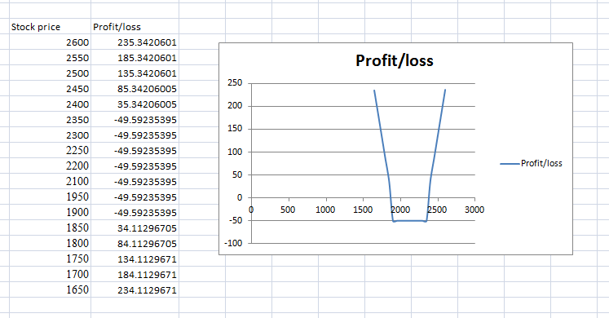
REAL DATA ANALYSIS (CONT...)
Following results were obtained:

Slide 35
THANK YOU

